Slide 1


Reverse Engineering Malware
IDA Pro – Part 2
Last Update: 08/06/2020

Slide 2
Reverse Engineering Malware
Recognize C Constructs

Slide 3
Recognize C Constructs – Introduction
Malware commonly developed using C
Recognize assembly instructions as group in addition to single instructions
Malware analyst’s goal is to understand overall functionality of program
Focus on the way a program works in general

Slide 4
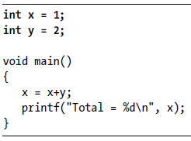
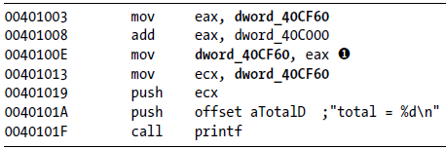

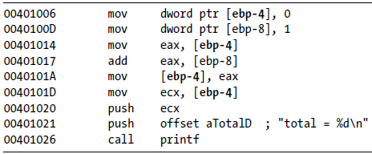
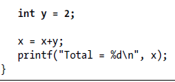
Recognize C Constructs – Global vs Local

Slide 5
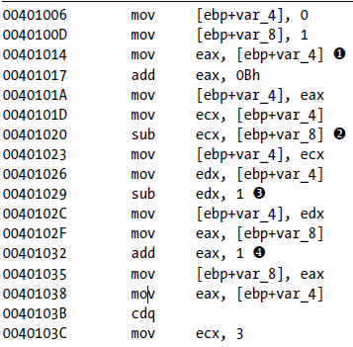
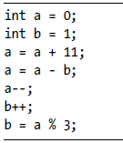

Recognize C Constructs – Arithmetic Operations

Slide 6
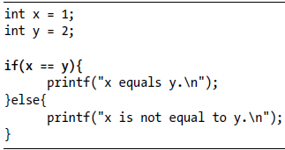
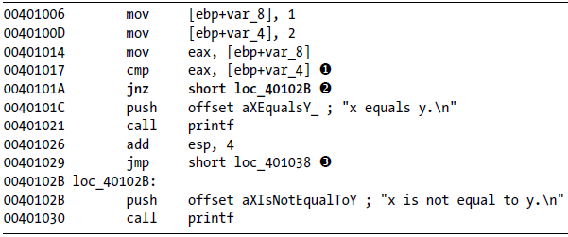
Recognize C Constructs – Recognize “If” constructs

Slide 7
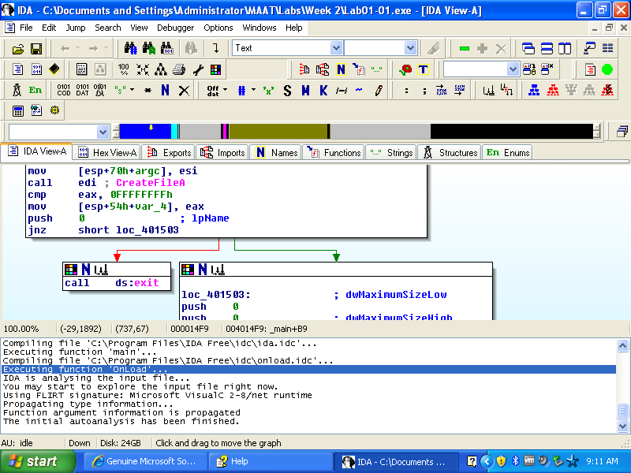
Recognize C Constructs – Recognize “If” graphically
false
true

Slide 8
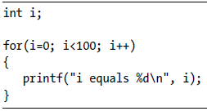
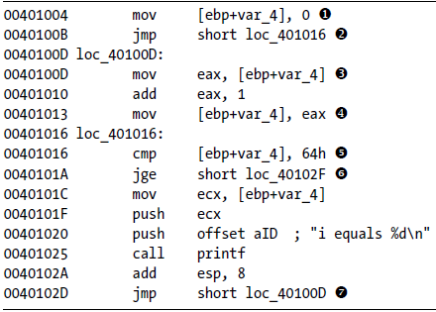
Recognize C Constructs – Recognize “For” Loops
Initialization
Increment
Comparison
Loop (another iteration)

Slide 9
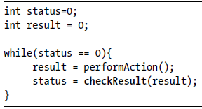
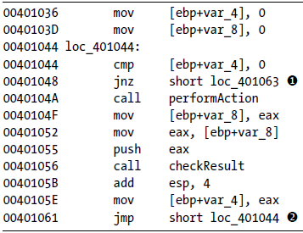
Recognize C Constructs – Recognize “While” Loops
Comparison and Exit
Loop (another iteration)

Slide 10
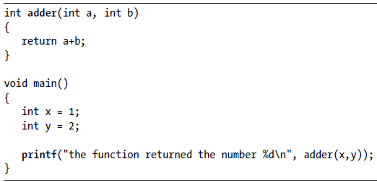
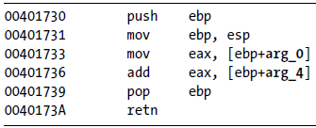
Recognize C Constructs – Recognize function calls

Slide 11
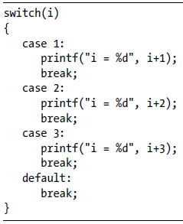
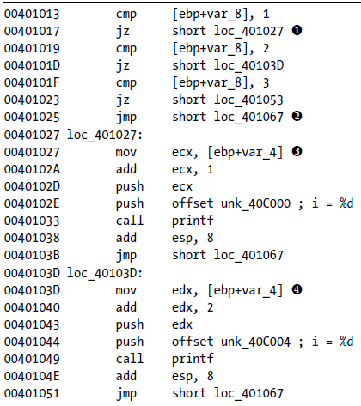
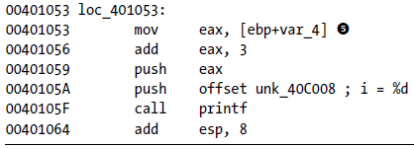
Recognize C Constructs – Recognize “switch” construct

Slide 12
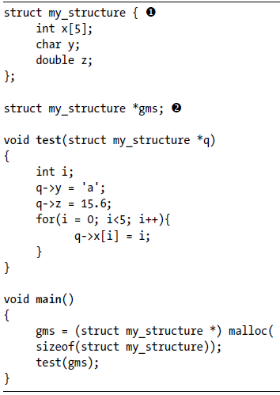
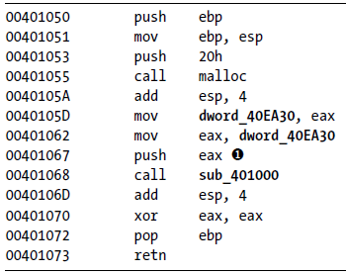
Recognize C Constructs – Recognize “struct” construct
global
Structures are accessed with base address

Slide 13
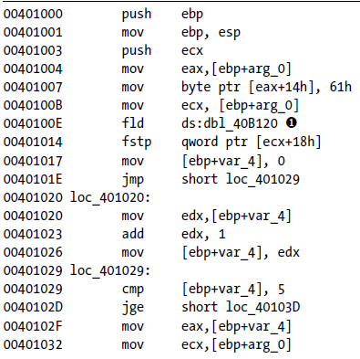
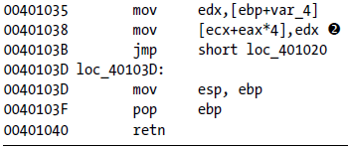
Recognize C Constructs – Recognize “struct” construct
global
Structures are accessed with base address
Notes:
A struct in the C programming language (and many derivatives) is a complex data type declaration that defines a physically grouped list of variables to be placed under one name in a block of memory, allowing the different variables to be accessed via a single pointer, or the struct declared name which returns the same address.

Slide 14
Reverse Engineering Malware
Refer to Sikorski Michael, Honig Andrew (2012).Practical Malware Analysis: The Hands-On Guide to Dissecting Malicious Software, No Starch Press (Page 142 for details)

